Slide 1
Density-based spatial clustering of applications with noise (DBSCAN)
By Dr. Ali Saeed

Slide 2
DBSCAN
It is clustering algorithm which is based on density
Means it develop clusters on the based of density parameter
Density: Number of points in the given area OR count the number of points in the given area. More points means more density
This algorithm input two points:
  Epsilon
  Min points

Slide 3
DBSCAN
This algorithm input two points:
  Epsilon
    This refers the radius of the circle
  Min points
    We will draw a radius with “Epsilon” distance→ if it contains minimum points → this point is known as “Core Point”
    We will also count the central point

Slide 4
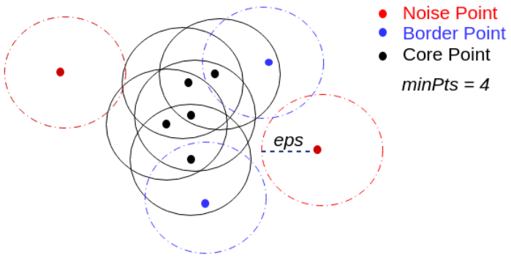
DBSCAN Core Points

Slide 5
DBSCAN
If a point is not a “Core” point then it is either: Noise or Boundary point
Boundary point
  If the point is near or neighbor of the core point
  Or it is withing a circle
Noise
  A point that is not Core point and not Boundary point is known as Noise
  Noise is also known as outlier
  DBSCAN is robust to find outlier

Slide 6
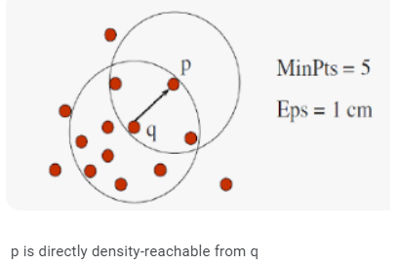
Directly Density Reachable
P is said to be directly density reachable form point Q if:
  P is neighbor of Q
  Q is core point
  Example:

Slide 7
DBSCAN Cluster
First we identify
  Core points
  Boundary Points
  Noise
Then, we will simply ignore the Noise.
We will check if one core point is neighbor of other core point that will get merged and considered as a single cluster.

Slide 8
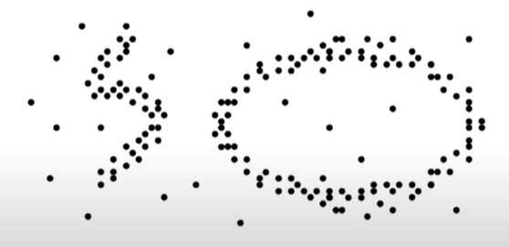
DBSCAN
DBSCAN is good algorithm to develop cluster on arbitrary shape data

Slide 9
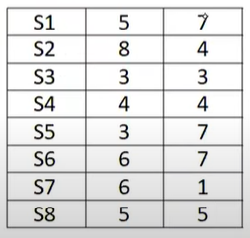
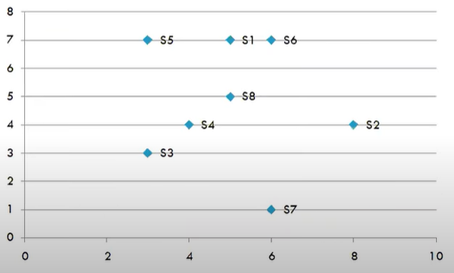
Example
Data points with graph

Slide 10
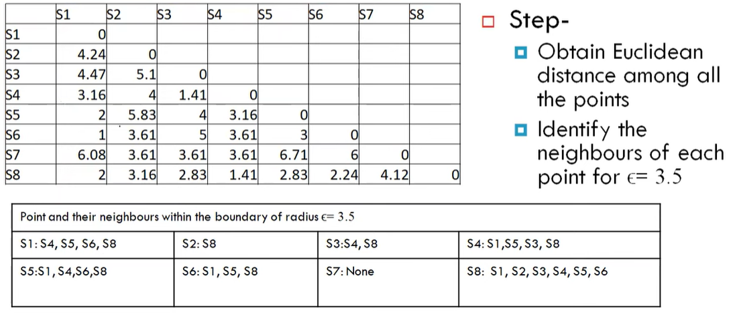
Euclidean Distance

Slide 11
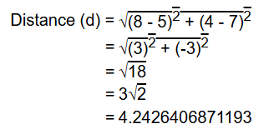
Euclidean Distance bw point S1 and S2

Slide 12
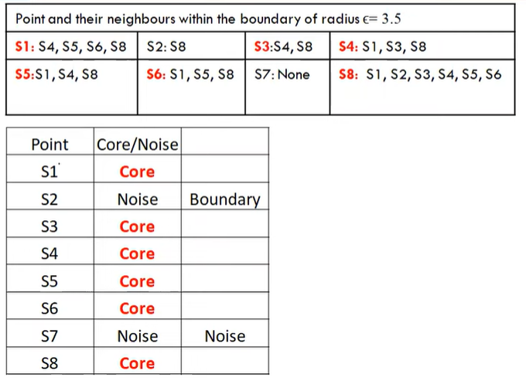
Check the type of points
As S2 is direct density reachable from
S8 so it will becomes Boundary Point
S7 is not direct density reachable from
any points

Slide 13
Thanks

